Slide 1
SUZLON ENERGY LTD
Business Case Analysis: “Financial Foundations”
Submitted By:
Devansh Bansal
220342
**The latest annual report available is of FY22. Thus, the analysis is limited to the information available till year data only.

Slide 2
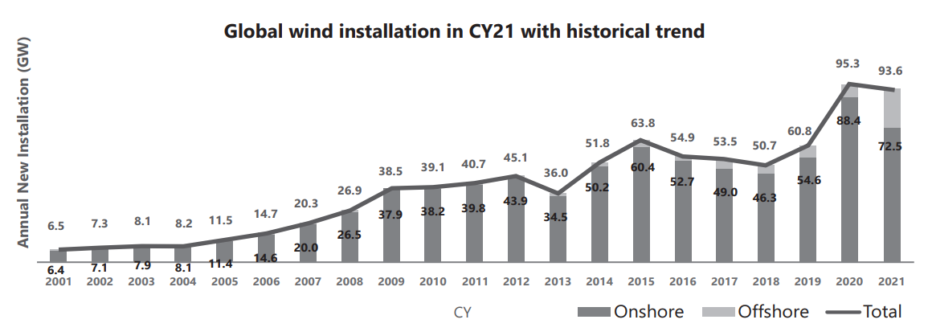
GLOBAL OUTLOOK
Global commitment towards renewable energy
As of 30 September 2021, 120 countries (representing just over half of global greenhouse gas emissions) had communicated new or updated NDCs (Nationally Determined Contributions). In addition, three G20 members have announced other new mitigation pledges for 2030. As an outcome of COP26, a total of 49 countries plus the EU have pledged to a net-zero target. As per experts, Wind energy is poised to play a vital role in accelerating the global energy transition.
Current Status
New wind energy installations stood at 93.6 GW, 3 times that of 2020. Additionally, wind energy sector registered a growth of 12% during 2021, which is handsomely more than the renewable energy sector growth of 9.1%. During the same period, renewable energy sector investment grew by 6.5% to reach $366 Billion.
Future Outlook
The wind energy sector CAGR for the next five years under current policies is forecast as 6.6% that means 557 GW of new capacity is estimated to be added in the next five years – which equates to more than 110 GW of new installations each year until 2026.

Slide 3
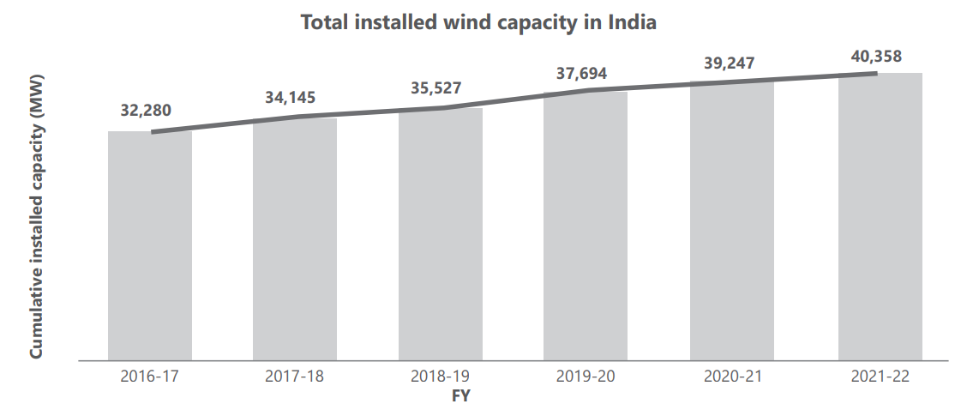
INDIAN OUTLOOK
India’s commitment towards renewable energy
At COP26, It was announced that the Indian government has set a goal to achieve "Net Zero" status by 2070. India also committed to build 500 GW of renewable energy capacity by 2030. To meet this target, wind energy will have to contribute 140 GW.
Current Status
As of FY22, India's installed renewable energy capacity stood at 161 GW in June 2022, amounting to 39.8% of the overall installed power capacity in the country. Within renewable energy, the contribution of wind energy currently stands at just over 25%.
Future Outlook
India with its 7,600 kilometers of coastline, has substantial untapped offshore wind resource potential. According to National Institute of Wind Energy (NIWE) assessment, India has more than 302 GW of onshore wind potential and 695 GW of onshore wind potential.
Key Drivers- Rising energy demand (2 times in 20 years), dedication towards "Net Zero", abundant availability of renewable sources, facilitative policies accelerating energy transition, tech maturity and high PLF.

Slide 4
QUANTITATIVE ASSESSMENT
The following quantitative analysis were performed to analyze the balance sheet and income statement data of the last five years.
Common Size Analysis
Common Size Horizontal (Trend) Analysis of Balance Sheet and Profit & Loss Statement.
Ratio Analysis
Calculated and analyzed Liquidity ratios, Solvency ratios, Activity ratios, Profitability ratios.
Common Size Analysis Key Insights
Observations/Issues | Implications
Average trade receivables are ~ 22% of the total asset value. | High trade receivables mean the firm is exposed to credit risk.
Total Equity is highly negative. | This could also increase the cost of borrowing for the company as investors or lenders would rethink before lending.
On average the debt is much higher than the total assets value. | This implies that the firm is over leveraged with high amount of liabilities. This could worsen the situation for the company if the industry outlook is not great. Because along with bearing the losses, the company needs to pay interest cost.
COGS costs nearly 60% of total sales | This signifies a significant chuck of cost is attributed to the raw material and conversion cost. Thus, it could minimise chance for the firm to earn profit if it doesn’t employee recourses efficiently and uses it capital prudently.
Interest cost is nearly 27% of the total sales | This means a significant (>1/4) chuck of sales is towards the repayment of the borrowings. Which is anticipatory in nature, as the firm capital structure is over leveraged.

Slide 5
QUANTITATIVE ASSESSMENT
Common Size Analysis Key Insights
Observations/Issues | Implications
Profit after tax is negative in 4 out of last 5 years | As the firms bears (~87% of the sales) towards just COGS and interest payment, the rest of the margin left is relatively small to manage the other costs. Thus results in negative PAT.
Ratio Analysis
Observations/Issues | Implications
Current Ratio is less than 1 | This means the current assets are not sufficient to meet the short-term current liabilities. Ideal range is 1.5-2.
Debt to Equity ratio is negative | The ratio is negative due to negative total equity value. It signifies that the company's liabilities exceed its assets. This can be an indication of financial distress and potential insolvency. This can be an indication of financial distress and potential insolvency.
Financial leverage is negative in nature. | Due to overreliance on debt financing, company exposes itself to finance risk and could restrict the company's ability to raise additional capital or secure favourable financing terms.
High average receivables days ~150 days (close to 5 months) | High receivable days means the it takes long time for the company to collect payment from its customers after making sales. Thus exposes it to credit risk which could result in liquidity issues and hinder the company's ability to fund its operations effectively.

Slide 6
QUALITATIVE ASSESSMENT
PECKING ORDER THEORY
The Pecking Order Theory is a theory suggests how a company should ideally finance, based on that indicates how a company is performing and its capital structure.
1. Internal Financing - If the company is going strong, it should normally fund itself internally, through retained earnings.
However, in Suzlon case, this is not feasible since their retained earnings are negative, as both its PAT and last year retained earnings are negative in nature.
2. Debt Financing - If the management is confident that the company is consistently able to meet its monthly obligations, it should ideally finance itself through debt.
This is also not the ideal way for Suzlon, as its current ratio is less than one, which means that the company is not able to meet even its short-term liabilities with current assets in place. And since its profits and equity value are negative, company would find it difficult to raise debt at favorable terms.
3. Equity Financing - If the company is not going well and its stock is trading at premium (overvalued), it should try to finance itself by issuing new stocks, in order to make at least some money before its share price takes a huge hit.
In Suzlon case, Negative profits and negative equity can make it challenging to attract equity investors as they may perceive a higher level of risk and uncertainty about the company's financial performance. Raising equity capital in such circumstances may result in significant dilution of ownership for existing shareholders.
RECOMMENDATION
Considering Suzlon capital structure and performance, it may need to explore a combination of measures, which could include cost-cutting measures, restructuring, negotiations with creditors, asset sales, or seeking strategic partnerships through securing long-term orders to seize the growing wind energy capacity in India. Once the performance improve, it could opt for one of these financing options based on circumstances and available alternatives at that time.

Slide 7
STRATEGY FOR IMPROVEMENT
Issue | Strategy for improvement
Negative PAT | Cost Reduction and Efficiency Measures: Identify and reduce operational inefficiencies, unnecessary expenditures, and non-core activities. Along with it streamline operations, renegotiate contracts, and seek early payments from customers without compromising orders. Seizing the growing market opportunities: Develop marketing strategy to target the growing wind energy segment along with product improvement/differentiation. Abreast to this, the company should also secure strategic long-term order in pipeline. Since COGS + Finance cost are nearly ~87% of the sales, it is advisable to reduce debt levels in order to reduce the interest obligations(~27%)once the profitability starts improving.
Poor Liquidity | Working Capital Optimization: Analyze how working capital components like inventories and accounts payable are managed. Reduce inventory levels to save money and prevent overstocking. Optimize accounts payable by taking advantage of early payment discounts where feasible to reduce costs. Along with this, Suzlon could improve the receivables management to reduce credit risk.
Concerning Capital Structure (Negative Equity and High financial leverage) | Debt Refinancing and Negotiation: Evaluate options for refinancing existing debt to reduce interest costs or extend repayment terms. Explore opportunities to negotiate with lenders for more favorable terms, such as lower interest rates or relaxed covenants. Engage in constructive discussions with lenders to find mutually beneficial solutions. Asset Sales or Restructuring: Assess the possibility of selling non-core assets or underperforming divisions to generate cash and reduce debt. Equity Infusion or Capital Injection: Explore options to strengthen the company's capital base by attracting additional equity investments. This option reduces leverage and improves the balance sheet. However, it dilutes the ownership and considering current situation of the Suzlon, getting equity infusion is quite difficult as well.

Slide 8





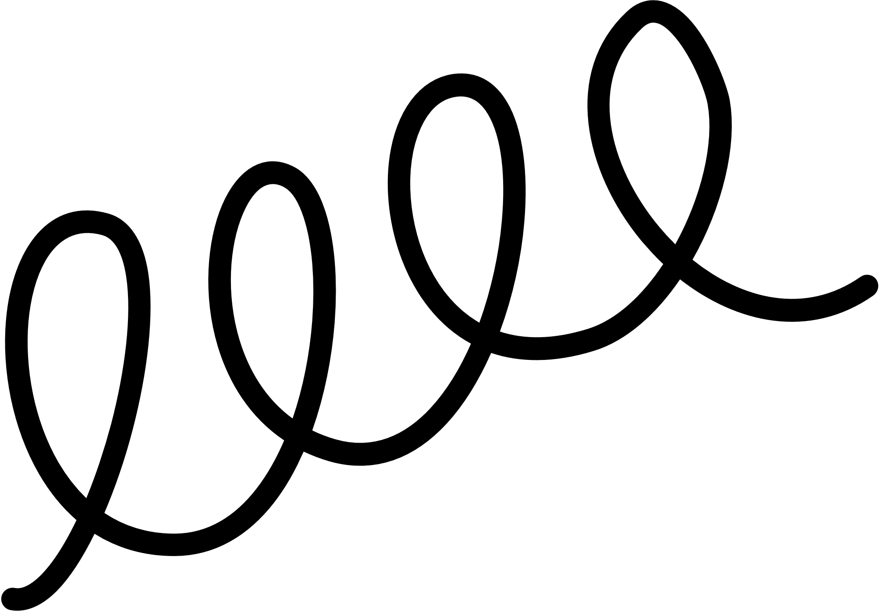
Thank You
Analysis Excel

Slide 9
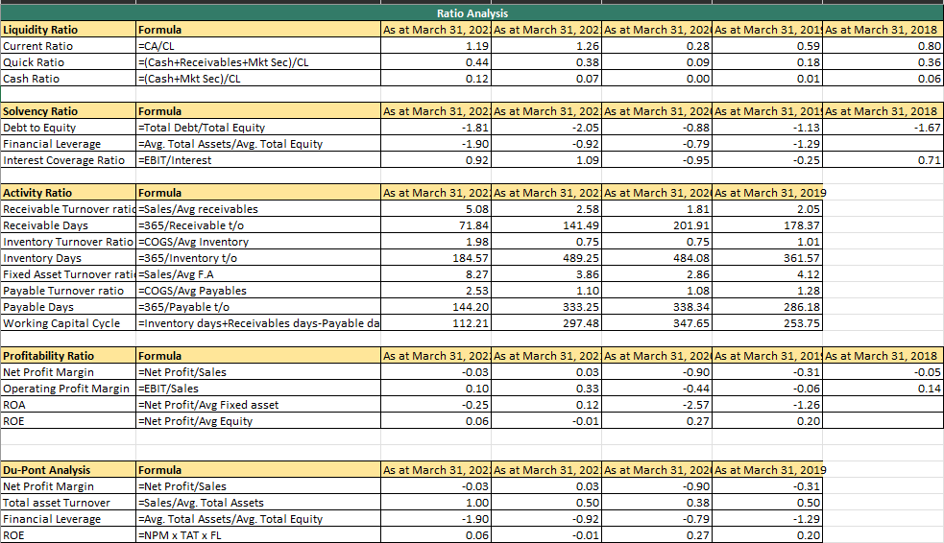
Annexure 1: Ratio Analysis

Slide 10
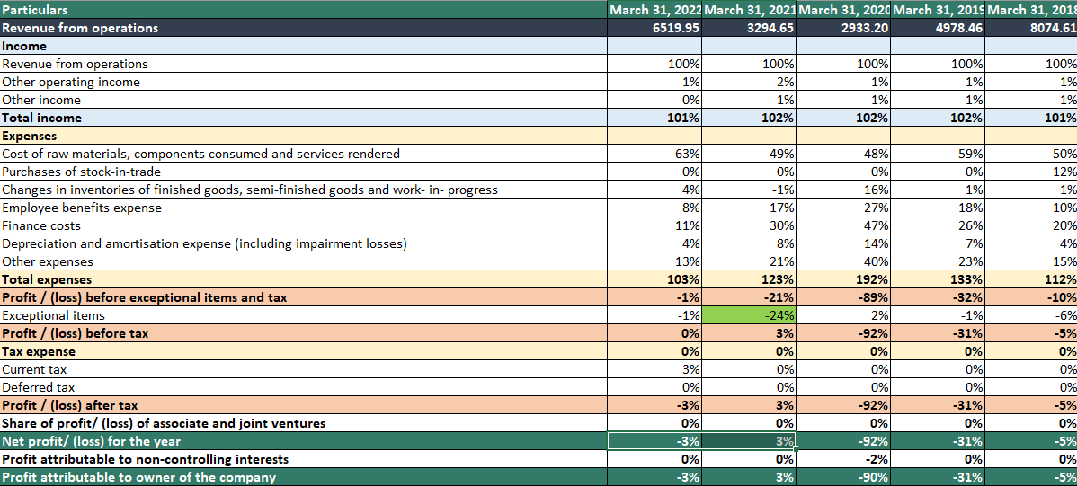
Annexure 2: Common Size Analysis

